Slide 1
Bank Analytics Group No. - 4
Created By –

Slide 2
Content
Introduction
Year wise loan amount Stats
Grade and sub grade wise revol_bal
Total Payment for Verified Status Vs Total Payment for Non Verified Status
State wise and month wise loan status
Home ownership Vs last payment date stats
Conclusion

Slide 3
Introduction
Bank analytics involves the use of data to gain insights into customer behavior, financial trends, and risk management. It plays a crucial role in optimizing processes and making informed business decisions.

Slide 4
Tools Used
Excel
MySQL
Tableau
Power BI

Slide 5
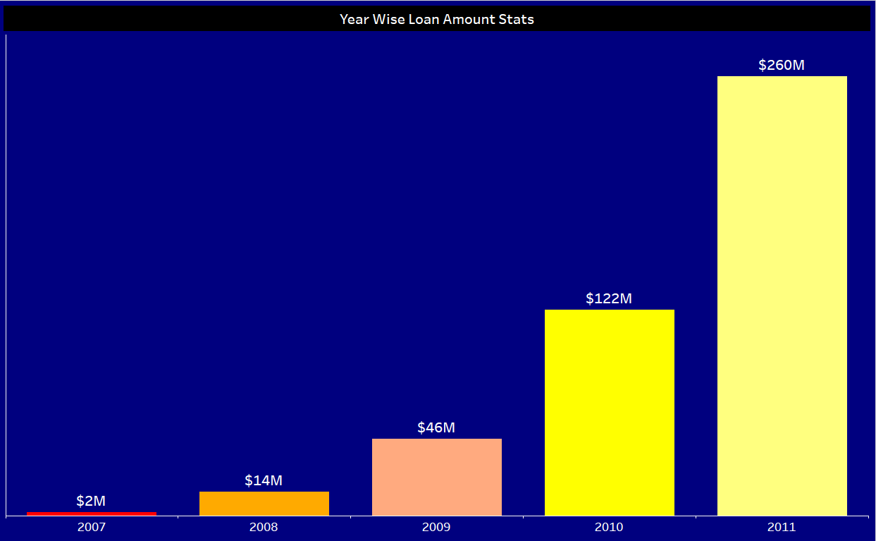
Year Wise Loan Amount Stats

Slide 6
Observation - The loan amount shows a significant increase each year, indicating a growing trend in borrowing over the period from 2007 to 2011.
Suggestion - Given the escalating loan amounts, it's advisable for financial institutions or lenders to closely monitor borrower creditworthiness and implement stringent risk assessment measures to mitigate potential default risks.
Conclusion - The consistent upward trajectory in loan amounts from 2007 to 2011 suggests either increasing demand for credit or relaxed lending standards during this period. This trend underscores the importance of prudent lending practices to maintain financial stability and minimize the likelihood of credit bubbles or financial crises.

Slide 7
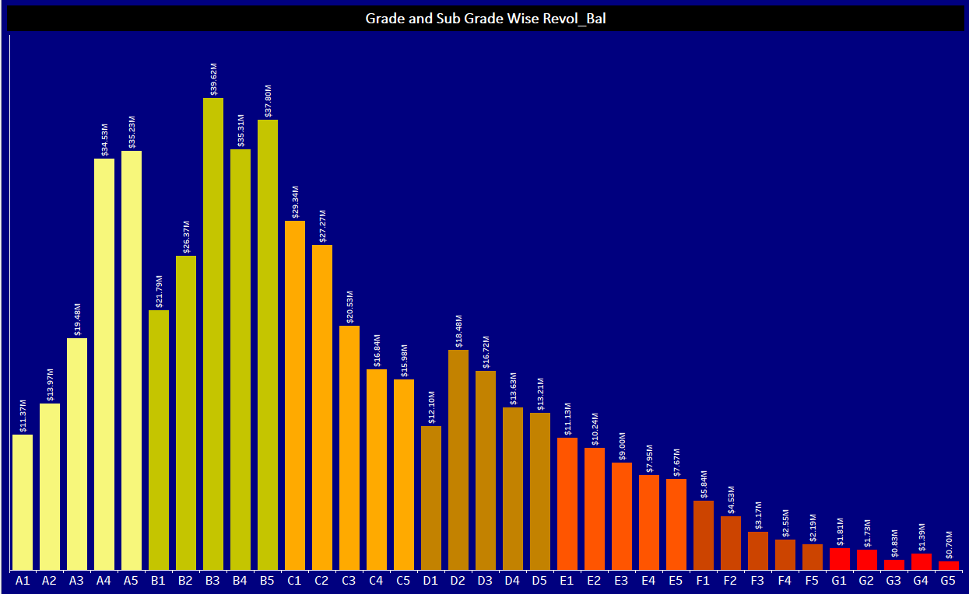
Grade & Sub-Grade Wise Revol_Bal

Slide 8
Observation - Revolving balances are increasing for grades A and B but decreasing for grades C through G, indicating varying patterns of credit utilization and debt management across different borrower risk categories.
Suggestion - For borrowers in grades A and B with increasing revolving balances, lenders may consider offering proactive financial education or counseling to promote responsible credit usage and prevent over-leveraging. For lower-grade borrowers (C through G), targeted interventions such as debt consolidation options or financial literacy programs could support better debt management and reduce revolving balances further.
Conclusion - The contrasting trends in revolving balances across different grade categories underscore the importance of tailored financial strategies for diverse borrower segments. Lenders should continuously monitor and adapt their approaches to risk management, ensuring they address the varying needs and behaviors of borrowers across different credit grades effectively.

Slide 9
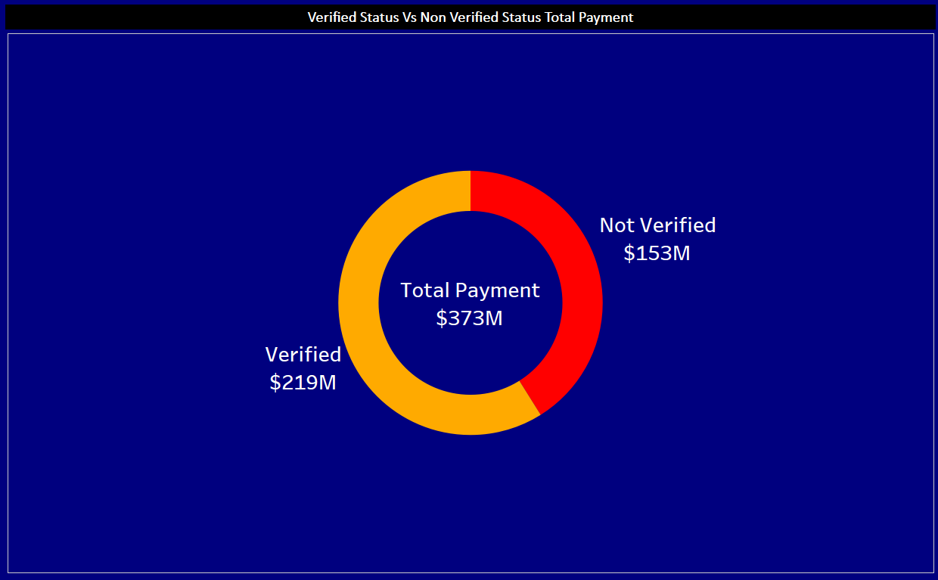
Verified VS Non-Verified Total Payment

Slide 10
Observation - The total payment amount is $373 million, with $219 million verified and $153 million non-verified, indicating that a significant portion of payments made is verified.
Suggestion - Implement robust verification processes to ensure a higher percentage of payments are verified, potentially reducing the risk of fraudulent or erroneous transactions and enhancing overall payment integrity.
Conclusion - While a substantial portion of payments is verified, efforts should be directed towards improving verification mechanisms to further enhance the accuracy and reliability of payment processing systems.

Slide 11
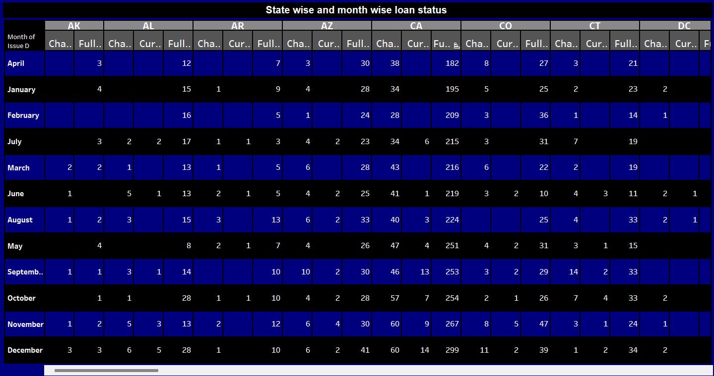
State Wise & Month Wise Loan Status

Slide 12
Observation - There are variations in loan statuses across different states and months.
Suggestion - Analyze factors contributing to fluctuations to optimize loan processing and management strategies.
Conclusion - Tailoring loan policies based on regional and temporal trends can enhance efficiency and mitigate risks.

Slide 13
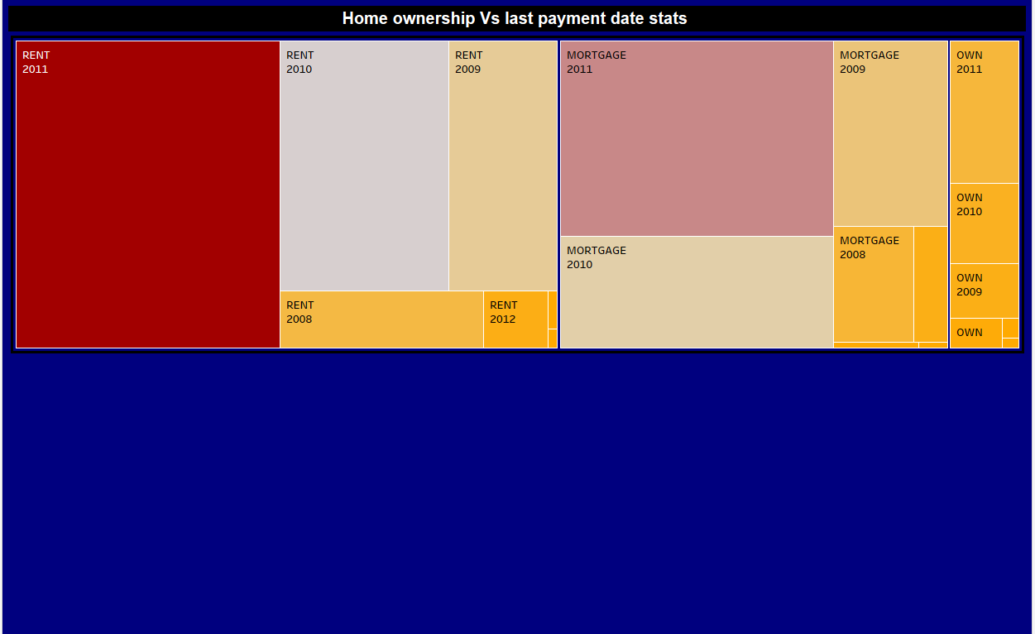
Home Ownership Vs Last Payment Date Stats

Slide 14
Observation - There is a diverse distribution of last payment dates across different categories of home ownership in the tree map visualization.
Suggestion – Need to explore correlations between home ownership status and payment behavior to inform targeted marketing or risk assessment strategies.
Conclusion - Understanding payment patterns based on home ownership status can guide personalized customer engagement and risk management approaches for the bank.

Slide 15
Conclusion
The bank analytics project revealed crucial insights across various KPIs. These included trends in year-wise loan amounts, distribution of revol_bal by grade and subgrade, payment disparities between verified and non-verified statuses, state and month-wise loan statuses, and relationships between home ownership and last payment dates. These findings offer actionable strategies, such as optimizing loan allocation, refining verification processes, and tailoring marketing efforts. Leveraging these insights can enhance operational efficiency, mitigate risks, and better serve customers, aligning with the bank's overarching objectives.

Slide 16
Thank You

